Slide 1
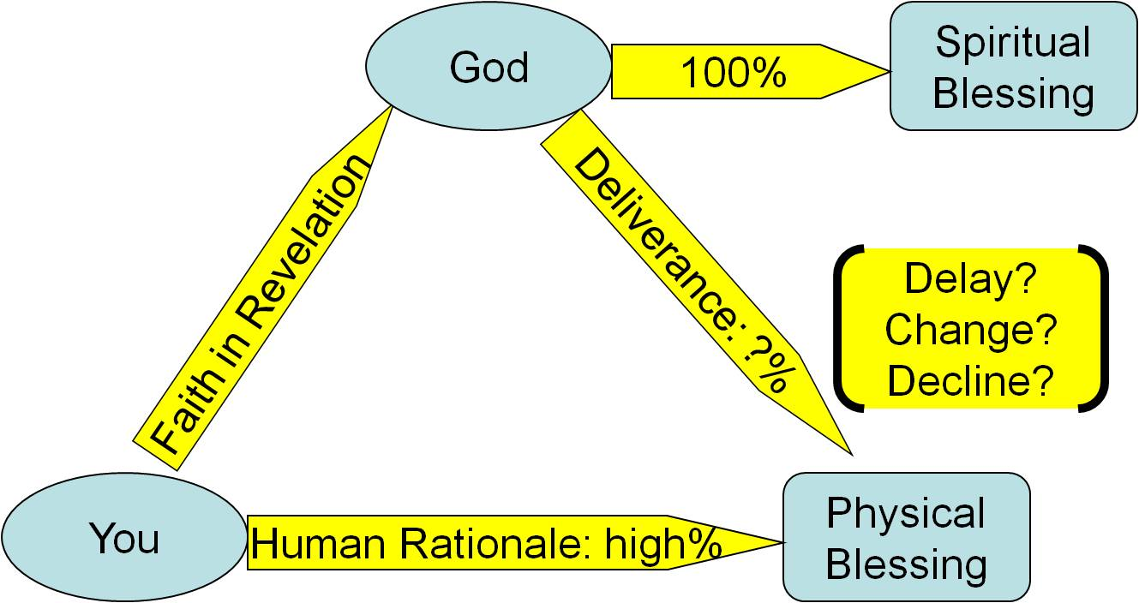
Resolving Conflict Biblically
arguing graphic from pixabay.com

Slide 2
What is your standard?
Whom will you please?
Whom will you glorify?
Respond to conflict on the
top line, empowered by God…
not on the bottom line
in your flesh.

Slide 3
Principle 1: Continue to love
Leviticus 19.17a NIV: Do not hate a fellow Israelite in your heart.
1 John 3.14 NET: We know that we have crossed over from death to life because we love our fellow Christians. The one who does not love remains in death.
Luke 6.27-28 NET, “Love your enemies, do good to those who hate you, bless those who curse you, pray for those who mistreat you.”

Slide 4
Principle 2: Even when you are hurting, try to help, not hurt.
Philippians 2.3-4 NIV: Do nothing out of selfish ambition or vain conceit. Rather, in humility value others above yourselves, not looking to your own interests but each of you to the interests of the others.
Romans 12.17-18 NIV: Do not repay anyone evil for evil. Be careful to do what is right in the eyes of everyone. If it is possible, as far as it depends on you, live at peace with everyone.

Slide 5
Principle 3: Prayerfully consider whether you need to change.
Leviticus 19.17 NIV: Do not hate a fellow Israelite in your heart. Rebuke your neighbor frankly so you will not share in their guilt.
Colossians 3.16 ESV: Let the word of Christ dwell in you richly, teaching and admonishing one another in all wisdom.
1 Thessalonians 5.12-13 NET: … acknowledge those who labor among you and preside over you in the Lord and admonish you, and to esteem them most highly in love because of their work. Be at peace among yourselves.

Slide 6
1 Timothy 5.19-20 NIV: Do not entertain an accusation against an elder unless it is brought by two or three witnesses. But those elders who are sinning you are to reprove before everyone, so that the others may take warning.
Luke 6.41-42 NIV, “Why do you look at the speck of sawdust in your brother's eye and pay no attention to the plank in your own eye? How can you say to your brother, ‘Brother, let me take the speck out of your eye,’ when you yourself fail to see the plank in your own eye? You hypocrite, first take the plank out of your eye, and then you will see clearly to remove the speck from your brother's eye.”

Slide 7
Proverbs 28.13 NIV: Whoever conceals their sins does not prosper, but the one who confesses and renounces them finds mercy.
Numbers 5.5-7 NIV: The LORD said to Moses, “Say to the Israelites: ‘Any man or woman who wrongs another in any way and so is unfaithful to the LORD is guilty and must confess the sin they have committed. They must make full restitution for the wrong they have done, add a fifth of the value to it and give it all to the person they have wronged.’”

Slide 8
Principle 4: If possible, let it go;
in any case, forgive.
Colossians 3.13 NIV: Bear with each other and forgive one another if any of you has a grievance against someone. Forgive as the Lord forgave you.
Matthew 6.14-15 NIV: For if you forgive other people when they sin against you, your heavenly Father will also forgive you. But if you do not forgive others their sins, your Father will not forgive your sins.

Slide 9
Luke 17.3-4 NIV: “If your brother or sister sins against you, rebuke them; and if they repent, forgive them. Even if they sin against you seven times in a day and seven times come back to you saying ‘I repent,’ you must forgive them.”
Matthew 18.21-22 NIV: Then Peter came to Jesus and asked, “Lord, how many times shall I forgive my brother or sister who sins against me? Up to seven times?” Jesus answered, “I tell you, not seven times, but seventy-seven times.”

Slide 10
Principle 5:
Seek to restore relationships.
Galatians 6.1-2 NIV: Brothers and sisters, if someone is caught in a sin, you who live by the Spirit should restore that person gently. But watch yourselves, or you also may be tempted. Carry each other's burdens, and in this way you will fulfill the law of Christ.
Ephesians 4.1-3 NET: I, therefore, the prisoner for the Lord, urge you to live worthily of the calling with which you have been called, with all humility and gentleness, with patience, bearing with one another in love, making every effort to keep the unity of the Spirit in the bond of peace.

Slide 11
Principle 6: Speak in an edifying way.
Romans 14.19 NET: So then, let us pursue what makes for peace and for building up one another.
Ephesians 4.29 NIV: Do not let any unwholesome talk come out of your mouths, but only what is helpful for building others up according to their needs, that it may benefit those who listen.

Slide 12
Principle 7: Work hard to work things out.
Matthew 5.23-24 NIV: “Therefore, if you are offering your gift at the altar and there remember that your brother or sister has something against you, leave your gift there in front of the altar. First go and be reconciled to them; then come and offer your gift.”

Slide 13
Principle 7: Work hard to work things out.
Matthew 18.15 NET: If your brother sins, go and show him his fault when the two of you are alone. If he listens to you, you have regained your brother.
Proverbs 16.24 NIV: Gracious words are a honeycomb, sweet to the soul and healing to the bones.
Proverbs 18.13 NIV: To answer before listening-- that is folly and shame.

Slide 14
Principle 7: Work hard to work things out.
Romans 12.14 NIV: Bless those who persecute you; bless and do not curse.
Romans 12.21 NIV: Do not be overcome by evil, but overcome evil with good.

Slide 15
Matthew 18.16 NET: But if he does not listen, take one or two others with you, so that at the testimony of two or three witnesses every matter may be established.
Matthew 18.17 NET: If he refuses to listen to them, tell it to the church. If he refuses to listen to the church, treat him like a Gentile or a tax collector.

Slide 16
Bottom Line Responses:
Peace Faking through Escape
1. Denying the problem exists or refusing to do what you need to do.
2. Avoiding the other person.
1 Samuel 19.9-10 NIV: While David was playing the lyre, Saul tried to pin him to the wall with his spear, but David eluded him as Saul drove the spear into the wall. That night David made good his escape.
3. Committing suicide.

Slide 17
Bottom Line Responses:
Peace Breaking through Attack
1. Unnecessary litigation.
1 Corinthians 6.1 NIV: If any of you has a dispute with another, do you dare to take it before the ungodly for judgment instead of before the Lord's people?
2. Force or intimidation.
3. Violence or murder.
Matthew 5.21-22 NET, “You have heard that it was said to an older generation, ‘Do not murder,’ and ‘whoever murders will be subjected to judgment.’ But I say to you that anyone who is angry with a brother will be subjected to judgment. And whoever insults a brother will be brought before the council, and whoever says ‘Fool’ will be sent to fiery hell.

Slide 18
Resolving Conflict Biblically
Ephesians 6.12 NIV: For our struggle is not against flesh and blood, but against the rulers, against the authorities, against the powers of this dark world and against the spiritual forces of evil in the heavenly realms.
arguing graphic from pixabay.com

